Slide 1
Process mining on the loan application
Case Study- Process of Dutch Financial Institute

Slide 2
Objectives
Business Process Flow
Variants Of process flow
Exploratory Data Analysis(EDA)
Root Cause Analysis For Loan Acceptance
Root Cause Analysis For Loan Rejection
Insights & Findings
Anomalies
Q&A

Slide 3
Business Process Flow

Slide 4
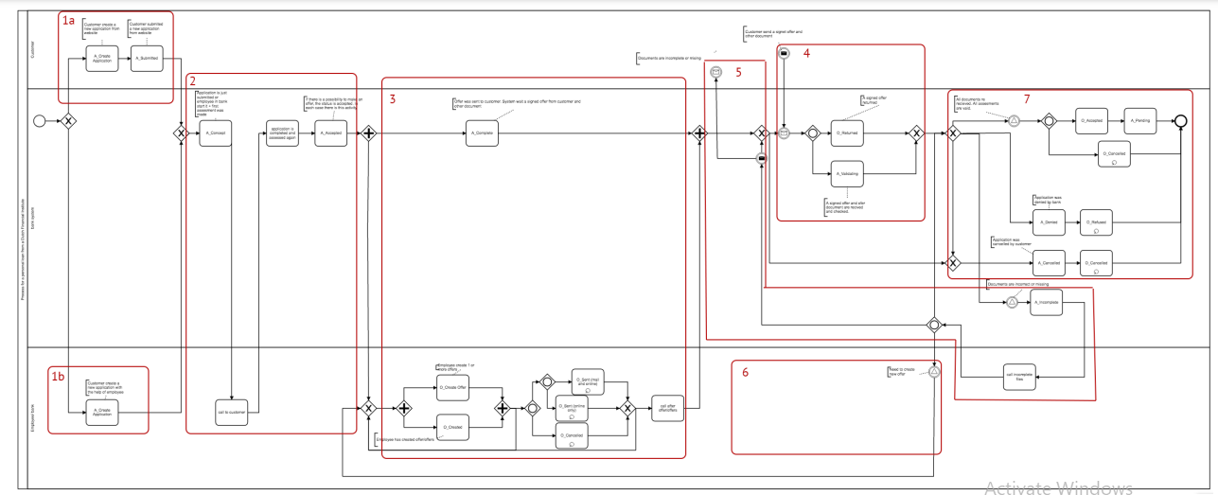
Business Process Flow
1

Slide 5
Variant Exploration

Slide 6
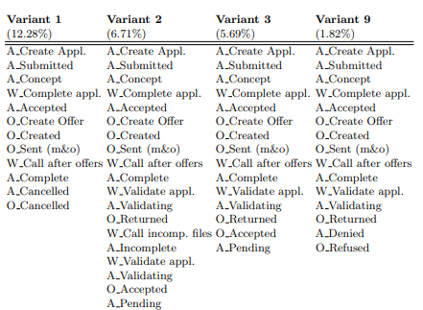
Variants Of Process Flow
1

Slide 7
Exploratory Data Analysis(EDA)

Slide 8
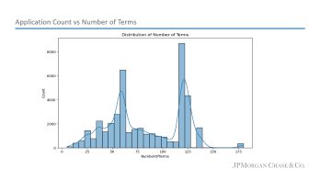
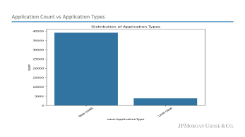
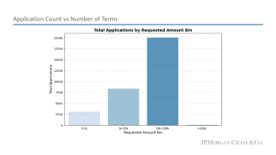
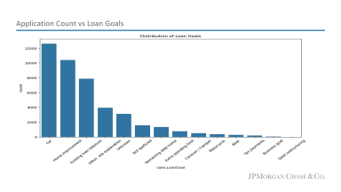

Distribution Of Loan Applications: Univariate Analysis
Univariate analysis reveals key trends in loan application data, including the most popular loan goals and requested amount ranges
Loan Goals
The most common loan goals are "Car" (12,000+) and "Home Improvement" (11,000+), dominating the distribution.
Additionally, "Other, see description" and "Not specified" collectively account for a significant number, highlighting uncategorized applications.
Application Type
The chart shows that most applications are for "New credit" (40,000+), significantly outnumbering "Limit raise" applications (<5,000).
This indicates that majority applicants seek new credit rather than increasing existing limits.
Number of Terms
The chart shows that the number of terms is multimodal, with several peaks.
The range of values is from 0 to 175. The mean and median are both around 90, suggesting a relatively symmetric distribution.
Requested Amount
Most loan applications (55.56%) fall within the "10k-100k" requested amount bin.
The remaining applications are distributed across "0-1k" (8.33%), "1k-10k" (22.22%), and ">100k" (13.89%).

Slide 9
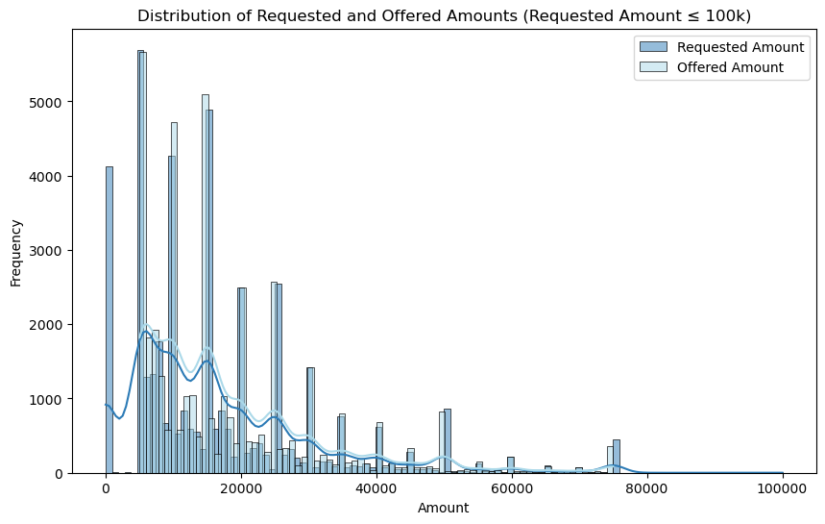
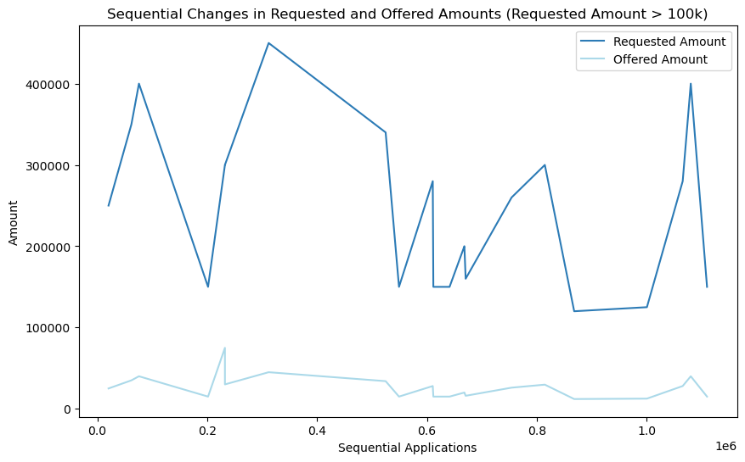
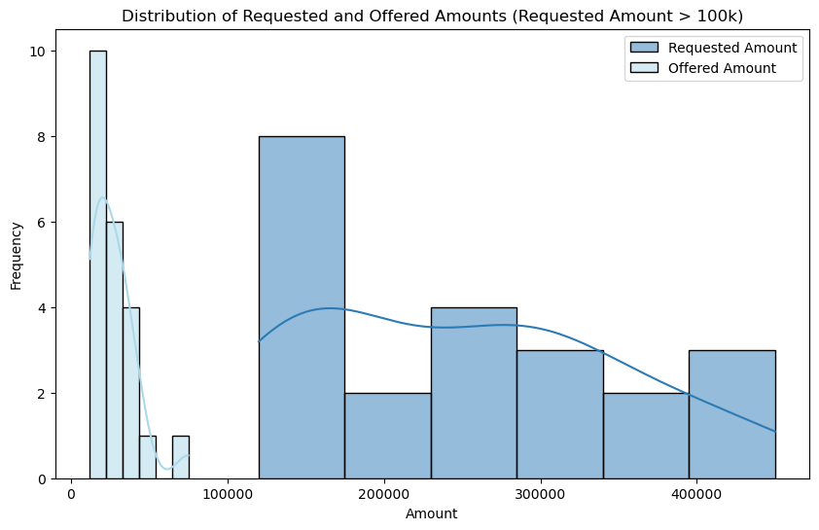
Requested Amount Vs Offered Amount
The graphs explore the relationship between requested and offered loan amounts, examining distributions for amounts below and above 100k, and analyzing sequential changes in offers for larger amount loan requests

Slide 10
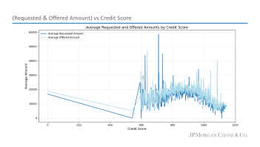
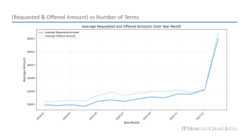
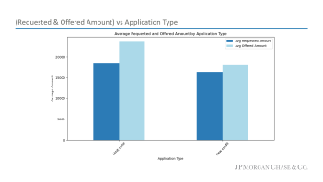
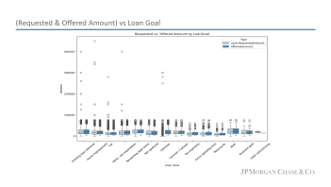
Distribution of (Requested & Offered Amount): Bivariate Analysis
Bivariate analysis explores relationships between loan characteristics (goals, type, terms etc) and loan amount dynamics (requested vs. offered)
Loan Goals
Offered amounts consistently fall below requested amounts across loan goals
In "Car" loans, the median offered amount is significantly lower than the median requested amount, Observed a general trend of lenders offering less than borrowers seek
Application Type
The chart reveals that "Limit Raise" applications have lower average requested amounts (~18,000) compared to "New Credit" (~16,000)
"Limit Raise" applications have a higher average offered amount (~24,000) than "New Credit" (~18,000)
Number of Terms
Both requested and offered amounts show an upward trend from 2016 to 2017, culminating in a significant increase in 2017-01
In 2017-01, the average requested amount was $40,000, while the average offered amount was $38,000, representing a 5% difference
Credit Score
Both average requested and offered loan amounts decrease as credit scores increase
For scores below 600, offers lag significantly behind requests, reflecting higher perceived risk for lower-credit borrowers.
For credit scores above 600, the average offered amount tends to increase slightly

Slide 11
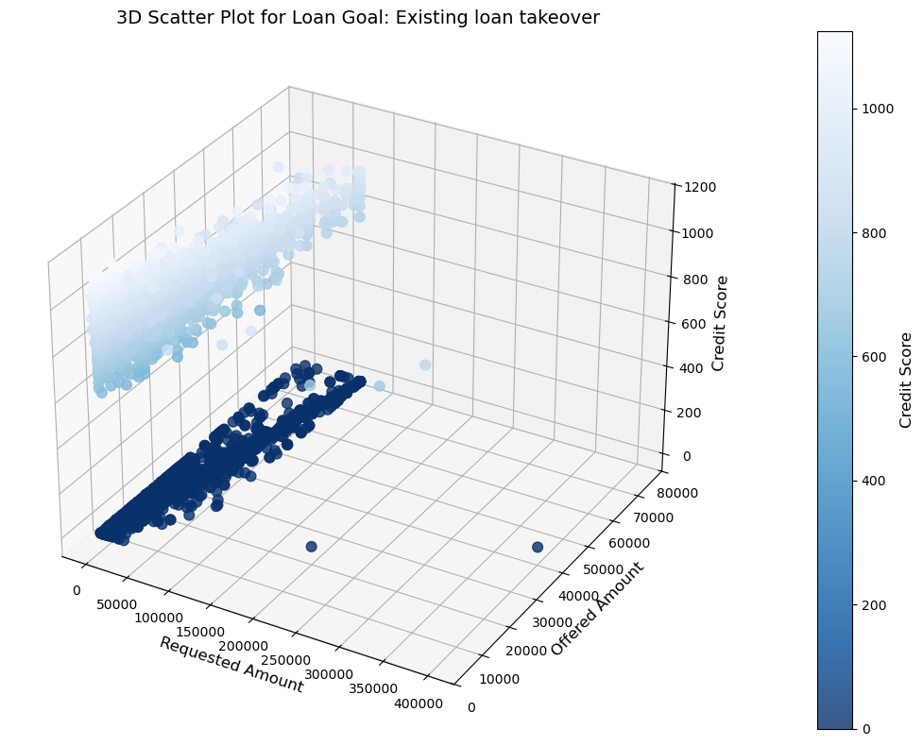
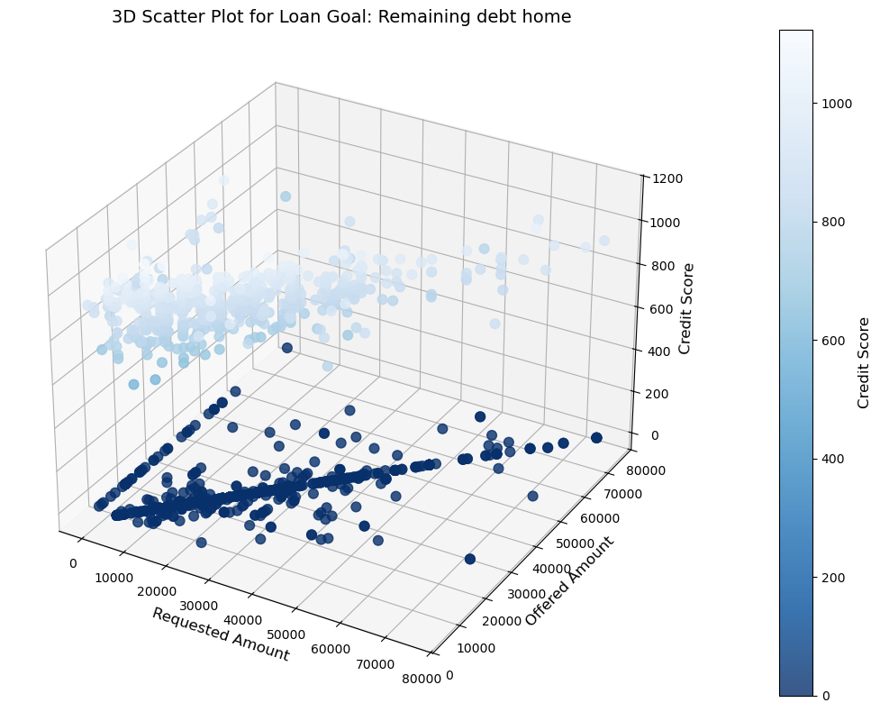
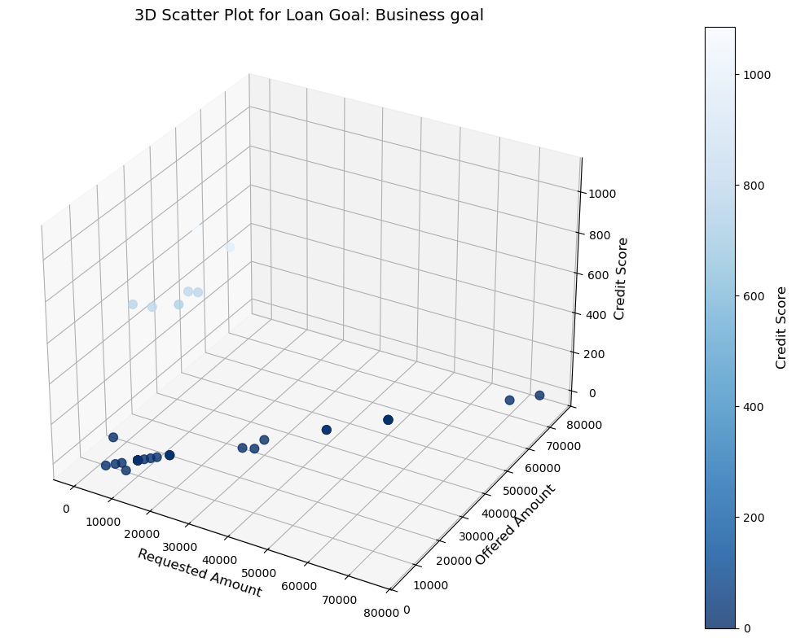
Distribution of Loan Amounts by Goal, Credit, and Offer: Multivariate Analysis
This analysis explores the relationship between requested and offered loan amounts, credit score, and three loan goals: Business, Debt, and Existing Loan Takeover

Slide 12
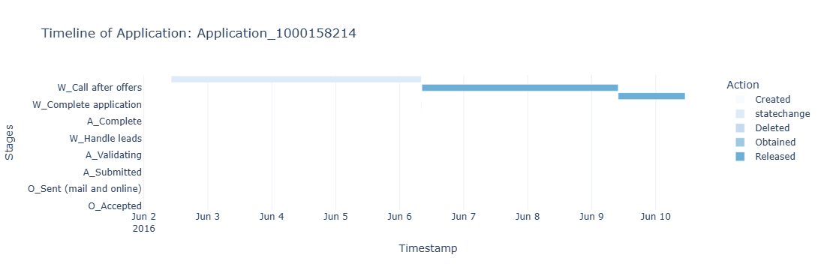
Lifecycle of an application: Multivariate Analysis
This timeline chart visualizes the progression of a single application through its various stages, from creation to acceptance, revealing key milestones and the time elapsed between each.

Slide 13
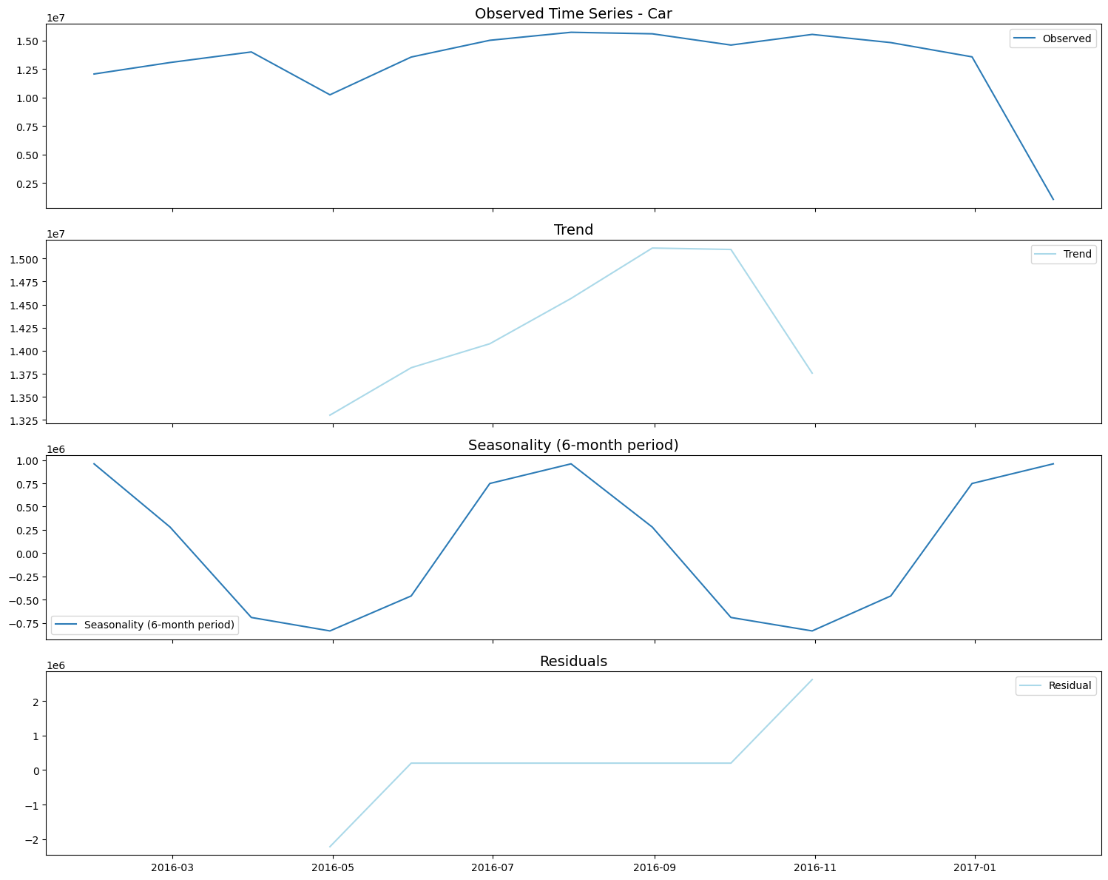
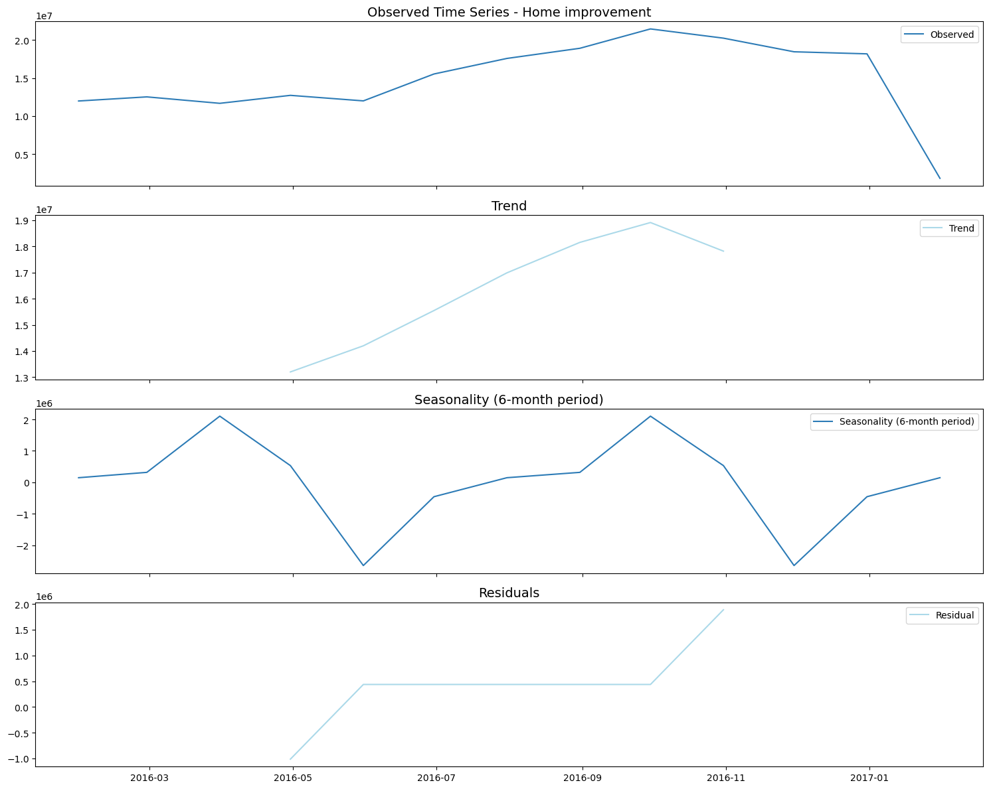
Trend & Seasonality Analysis
This analysis decomposes time series data for "Car" and "Home Improvement" loan applications into trend, seasonality, and residual components, revealing distinct temporal patterns for each goal type
Graph on average requested amount over time
Seasonality & Trend graph for few loan goals

Slide 14
Root Cause Analysis for Loan Acceptance

Slide 15
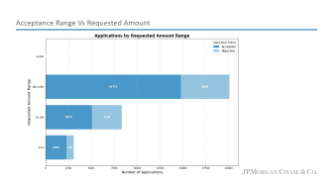
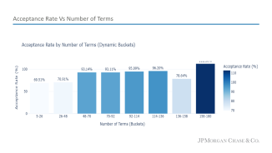
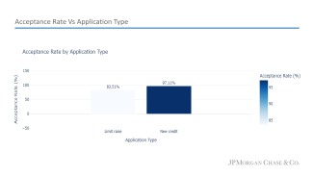
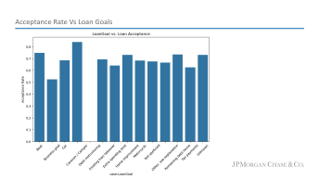
Loan Application Acceptance: Factors and Key Determinants
Analysis identifies key factors such as application type, number of terms, requested amount, loan goal that significantly impact loan acceptance rates.
Loan Goals
Car loans exhibit the highest acceptance rate (~80%), while business goals and debt restructuring have lower acceptance rates (~55-60%).
Other loan goals show moderate acceptance rates, indicating varying approval likelihoods across different loan purposes
Application Type
New Credit applications have a significantly higher acceptance rate (97.11%) compared to Limit Raise applications (83.51%).
This distribution highlights a strong focus on establishing new credit lines.
Number of Terms
Acceptance rates generally increase with the number of terms, reaching the highest levels for longer terms (92-136)
Major peak around 125 terms and a significant concentration between 50 and 150 terms
Requested Amount
Acceptance rates appear to vary across requested amount ranges.
Lower requested amounts (e.g., "1k-10k") may have higher acceptance rates.

Slide 16
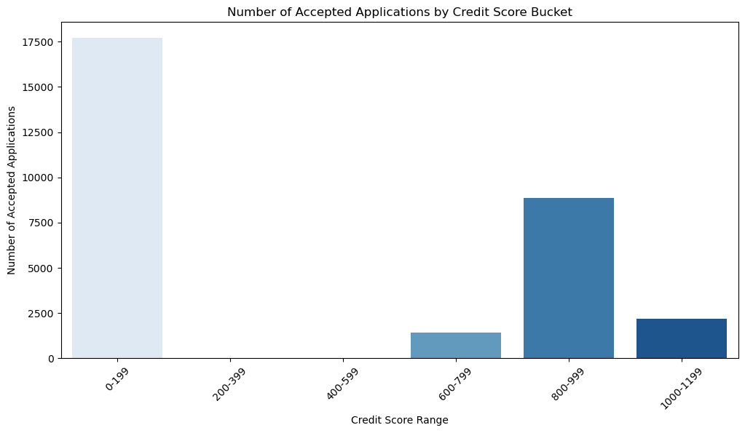
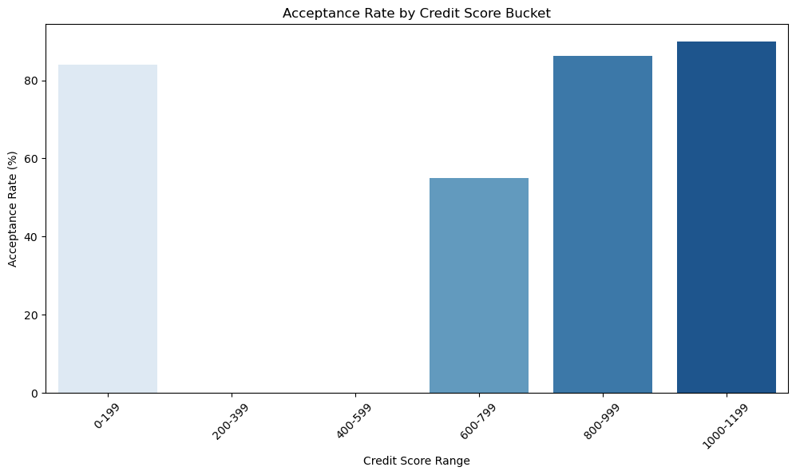
Credit Score : Analysis
This analysis between credit score and loan application acceptance indicate a strong correlation between higher credit scores and increased acceptance rates.
Applicants with credit scores in the 800-999 range have the highest acceptance rate (86.17%), while those with scores below 600 have significantly lower acceptance rates.
Credit Score Range | Total Applications | Accepted Applications | Acceptance Rate
0-199 | 21058 | 17708 | 84.09%
200-399 | 0 | 0 | NAN%
400-599 | 19 | 0 | 0.00%
600-799 | 2545 | 1401 | 55.05%
800-999 | 10289 | 8866 | 86.17%
1000-1199 | 2404 | 2161 | 89.89%
1

Slide 17
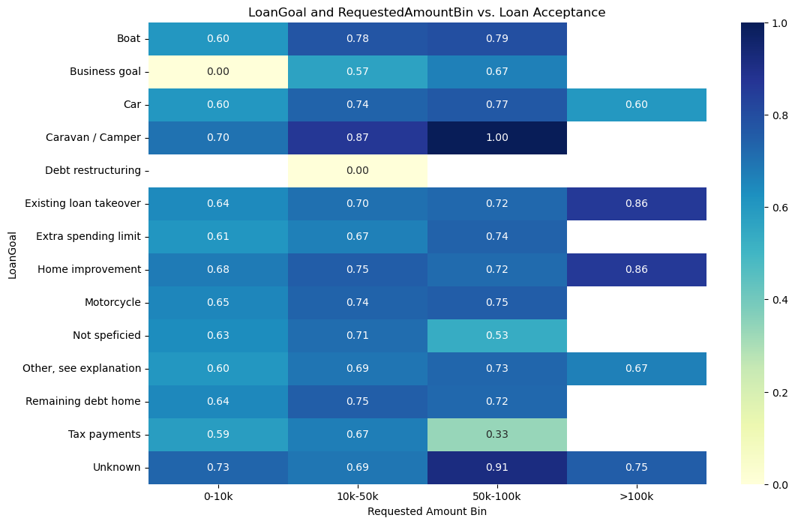
Loan Goal : Analysis
Loan Acceptance Varies: Acceptance rates differ significantly across loan goals and requested amounts.
High Acceptance: Goals like "Caravan/Camper" consistently show high acceptance rates regardless of the requested amount.
Low Acceptance: "Business goal" and "Debt restructuring" have consistently low acceptance rates.
Amount Influence: Acceptance rates for some goals (e.g., "Home Improvement") may vary depending on the requested amount.
Feature | Coefficient
Caravan / Camper | 0.84049
Unknown | 0.193144
Home improvement | 0.124361
Remaining debt home | 0.043822
Debt restructuring | -0.033486
Car | -0.042722
Motorcycle | -0.060027
Business goal | -0.088206
Existing loan takeover | -0.091157
Extra spending limit | -0.245964
1

Slide 18
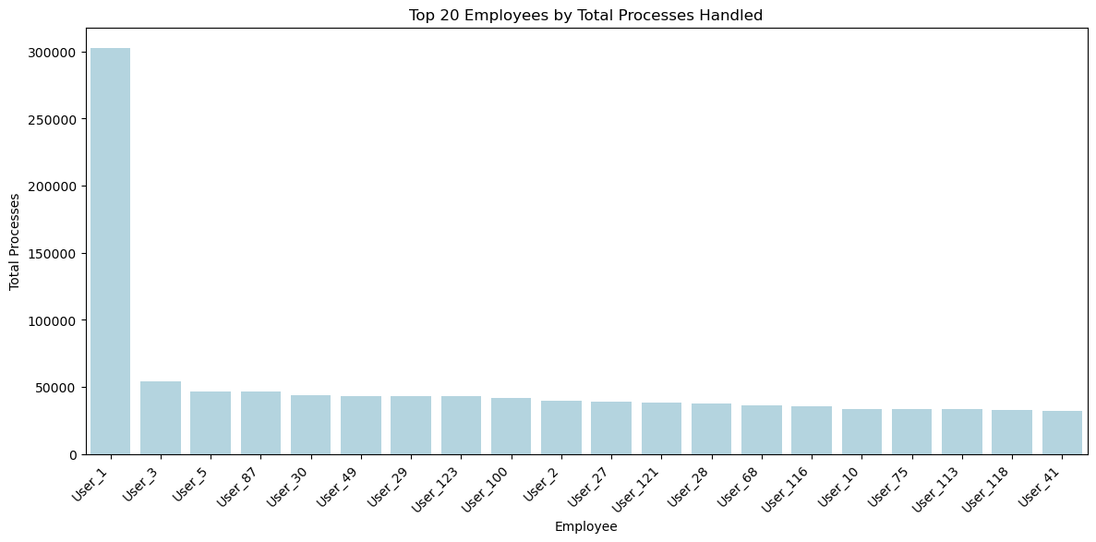
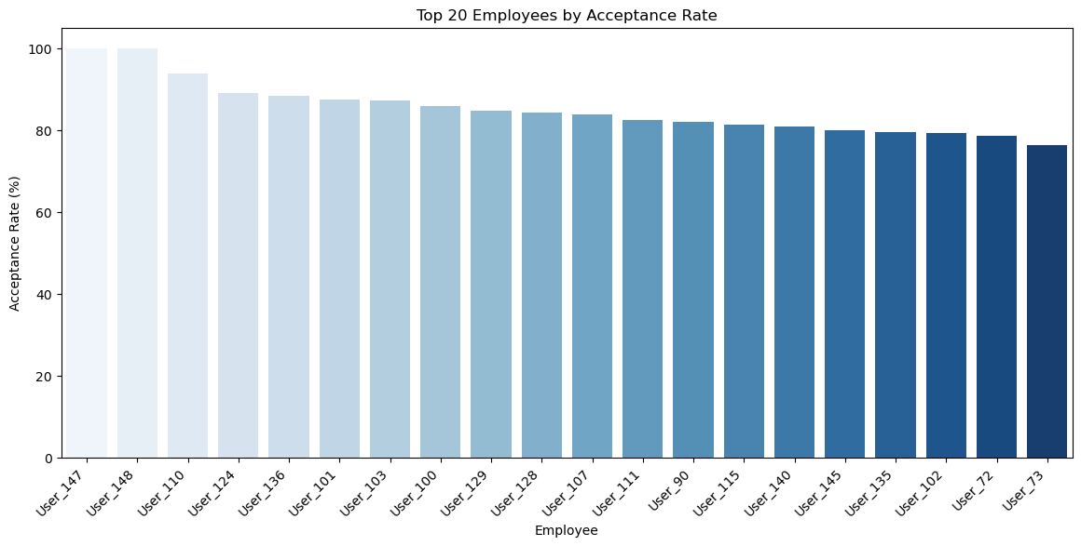
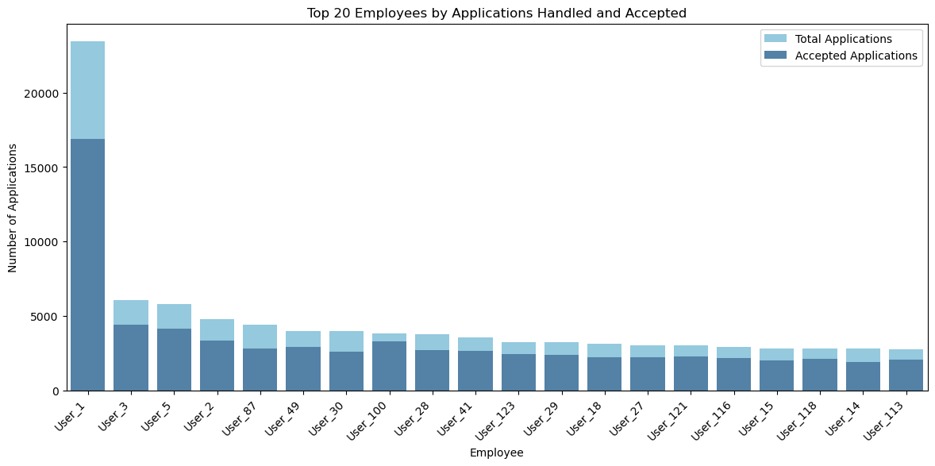
Behavior Analysis: Employees vs Acceptance
1

Slide 19
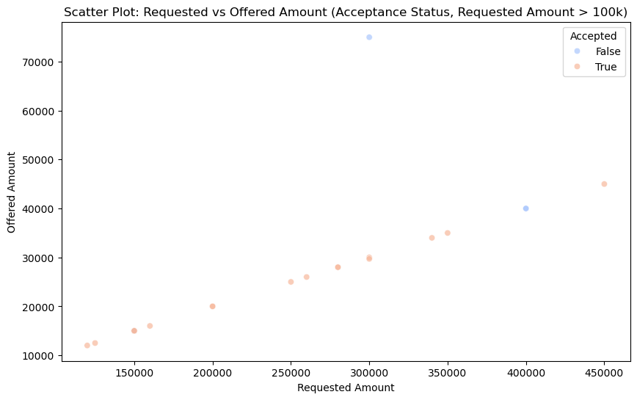
Requested Amount vs Acceptance
For loan applications exceeding 100k, revealing that while accepted applications generally have higher requested amounts, offered amounts often fall below the requested amount
1

Slide 20
Root Cause Analysis for Loan Rejection

Slide 21
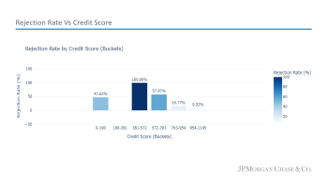
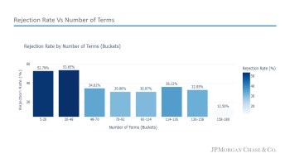
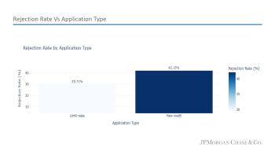
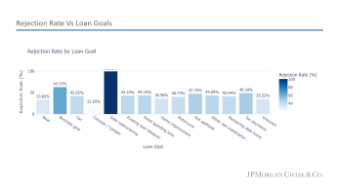
Loan Application Rejection: Factors and Key Determinants
Analysis identifies key factors such as application type, number of terms, loan goal, and credit score that significantly impact loan rejection rates.
Loan Goals
Debt Restructuring has the highest rejection rate (63.33%)
Business goals and Caravan/Camper have relatively high rejection rates (around 40%).
Boat, Car, and Home Improvement loans have the lowest rejection rates
Application Type
New Credit applications have a significantly higher rejection rate (42.15%) compared to Limit Raise applications (29.71%)
This indicates that applications for new credit lines are more likely to be rejected than requests to increase existing credit limits
Number of Terms
Rejection rates decrease with increasing number of terms
The lowest rejection rates are observed for loans with terms between 70-136
Loans with the shortest terms (5-26) have the highest rejection rates
Credit Score
Rejection rates decrease significantly with increasing credit scores
The lowest rejection rate (9.32%) is observed for the highest credit score bucket (954-1145)
The highest rejection rate (100%) is observed for the credit score bucket 381-572

Slide 22
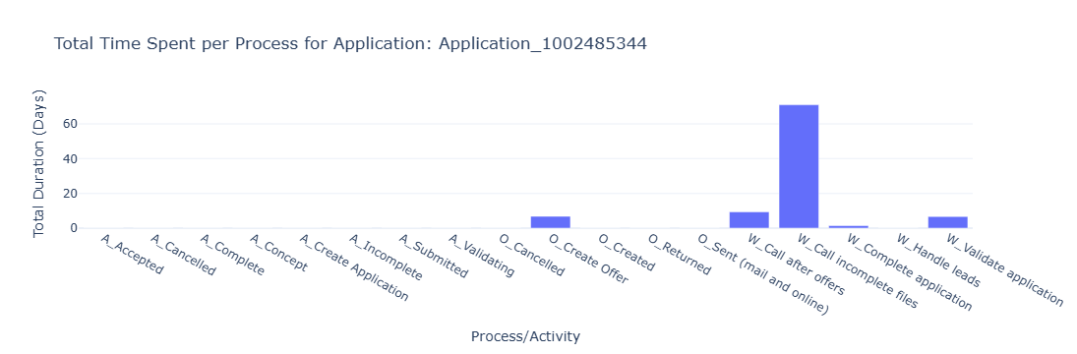
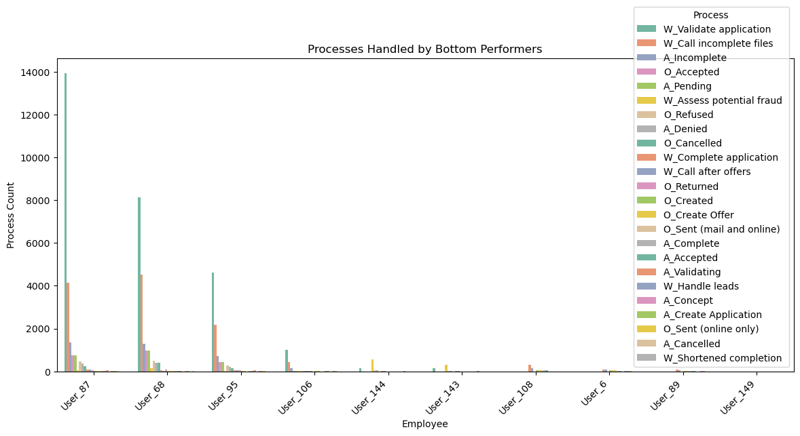
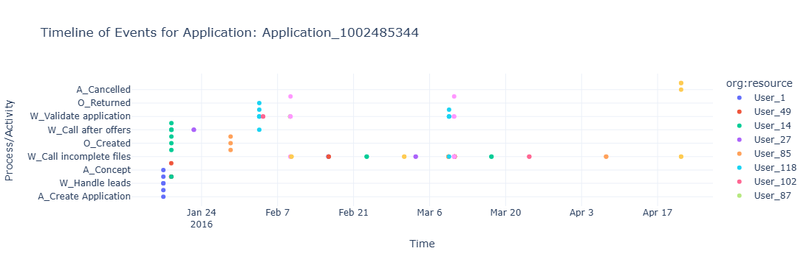
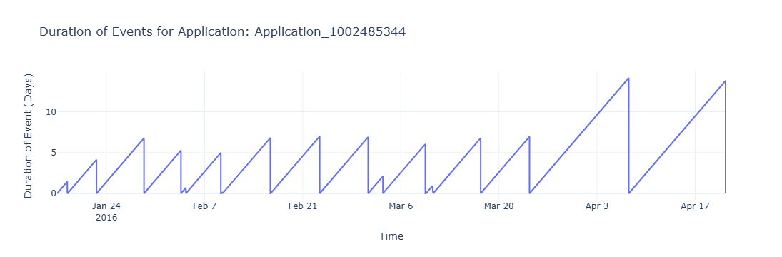
Behavior Analysis: Employees vs Rejection
1

Slide 23

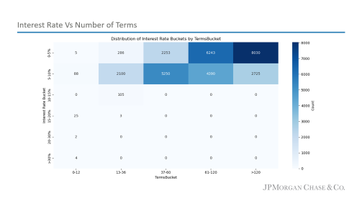
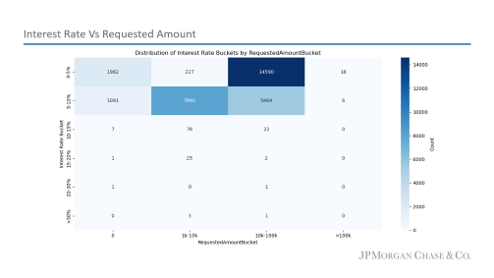
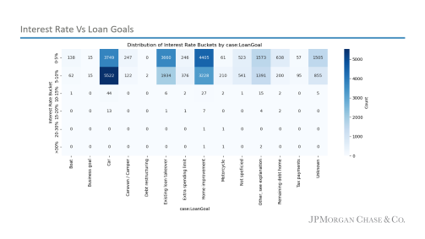
Insights or Findings
Interest Rate Distribution: Hypothesis
Term Impact: Longer loan terms associated with higher interest rates.
Goal-based Differences: Interest rates vary significantly across different loan goals.
Amount Influence: Higher loan amounts result in higher interest rates.

Slide 24
Anomalies
Requested Amount ==0 : 2345 Accepted Cases
Requested Amount < Offered Amount :2722 Accepted Cases
Requested Amount, Offered Amount
Credit Score =0 : 12462 Accepted Cases
Sudden Spike after 2017
Even with Zero credit score there are acceptance case
No clear demarcation unit for the number of terms
Random classification of loan goals
(e.g: Not specified, Unknown)
Loan Amount
Features logic
Data Inconsistencies
Gaps in following up with customer from employee end without any public holiday
Multiple employees handling the same application, incorrect assignments and case suspensions
Relation between first withdrawal amount, terms and goal not giving clear understanding (Lack of event mapping tables)
Less than 24 months data for Trend analysis
Null/missing records
Duplicate acceptance case : No key identifier : 5425 Records
Data Availability
Event Logs

Slide 25
Questions?

Slide 26
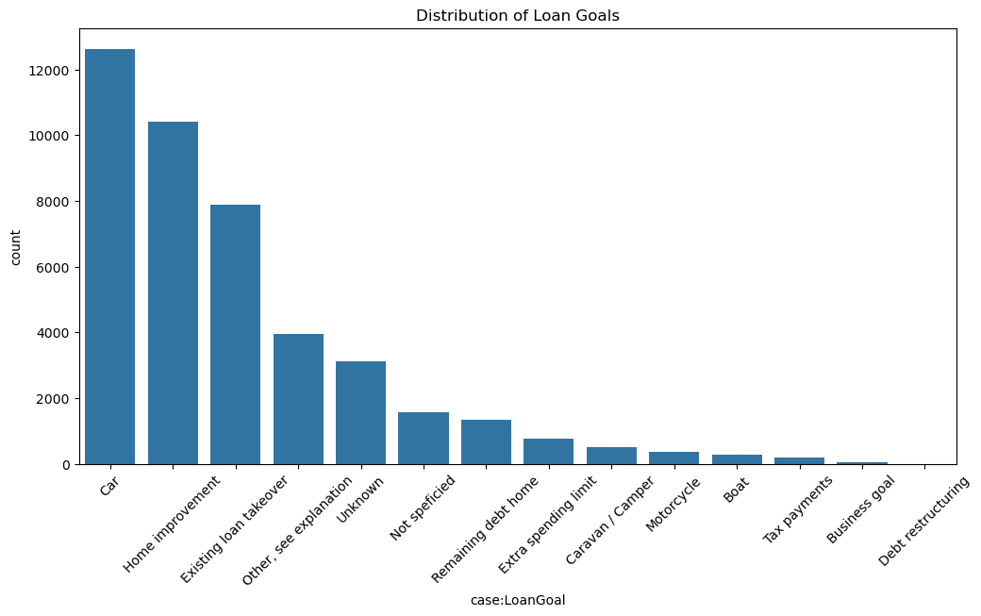
Application Count vs Loan Goals

Slide 27
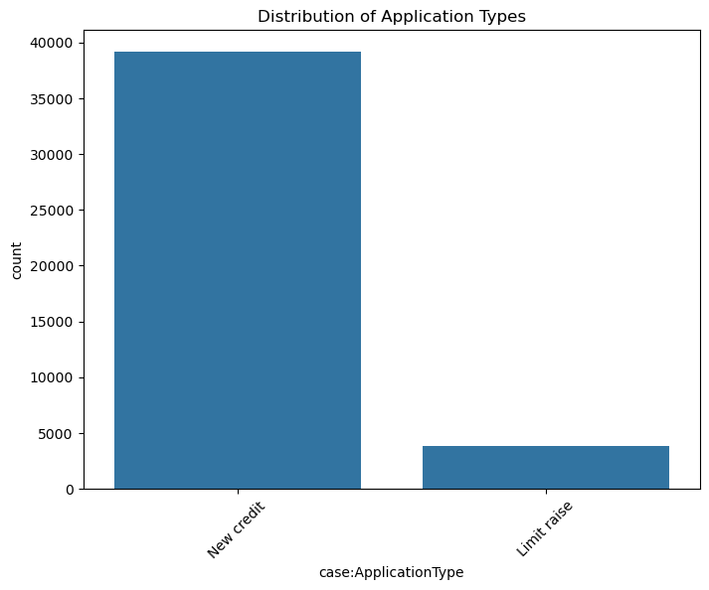
Application Count vs Application Types

Slide 28
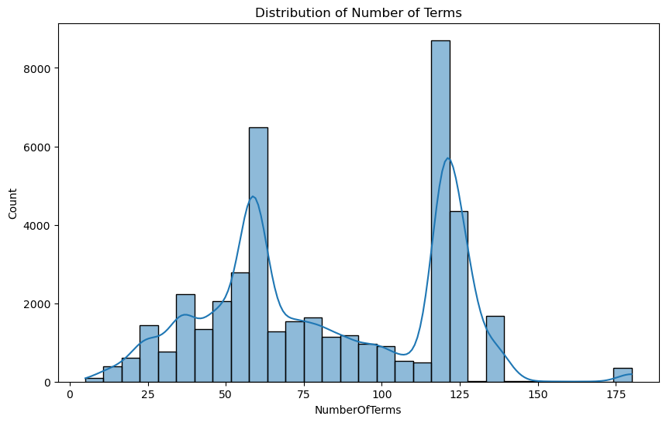
Application Count vs Number of Terms

Slide 29
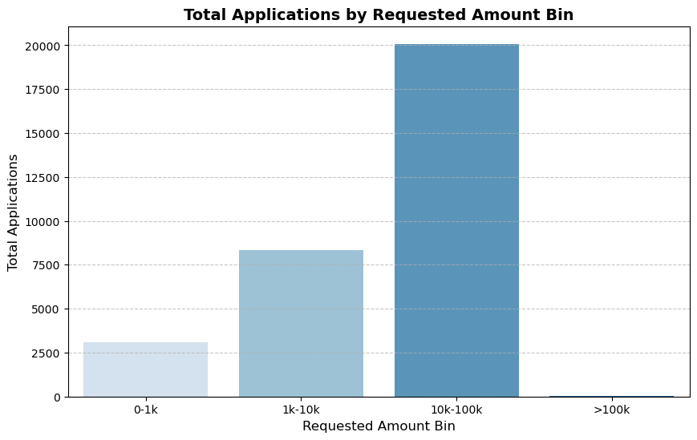
Application Count vs Requested Amount

Slide 30
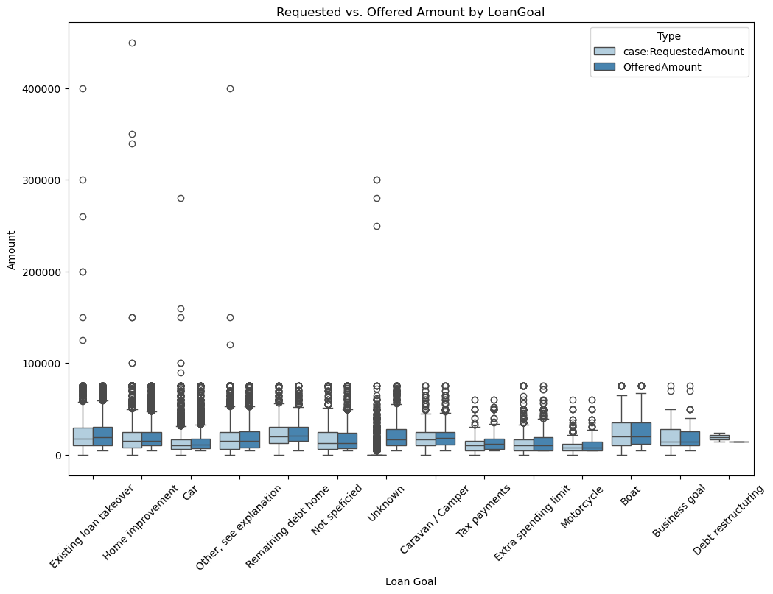
(Requested & Offered Amount) vs Loan Goal

Slide 31
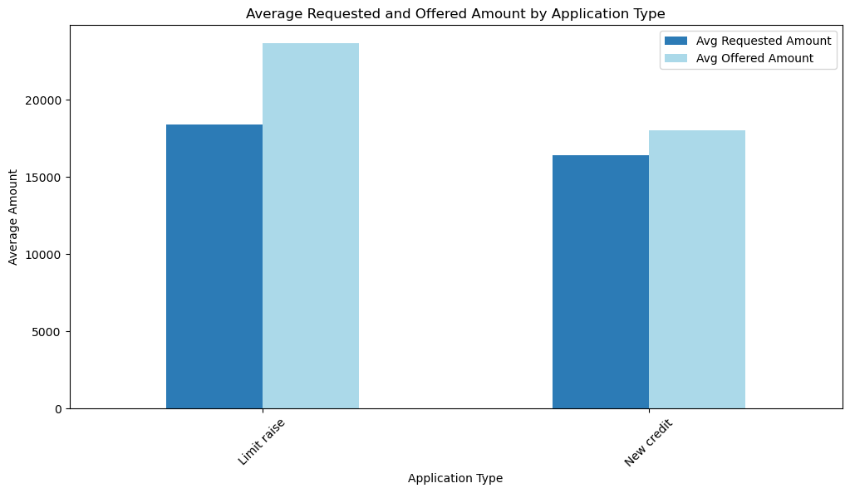
(Requested & Offered Amount) vs Application Type

Slide 32
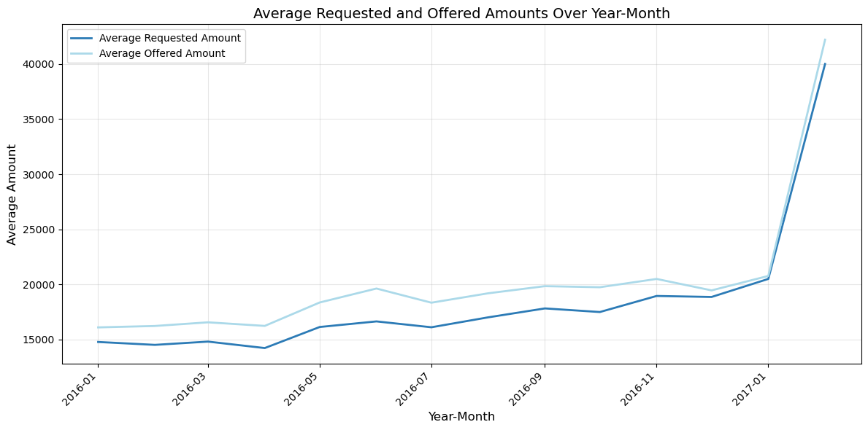
(Requested & Offered Amount) vs Number of Terms

Slide 33
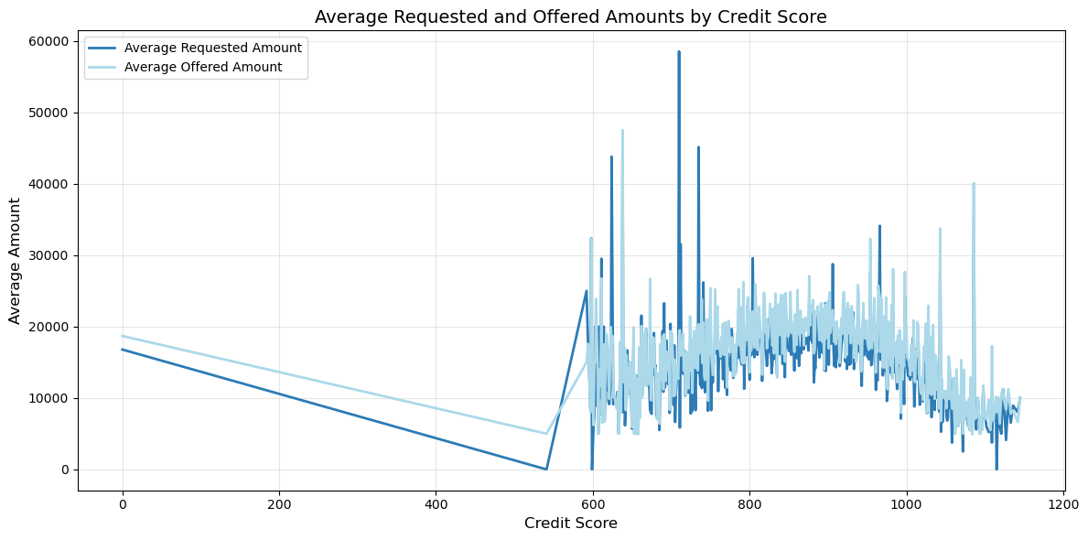
(Requested & Offered Amount) vs Credit Score

Slide 34
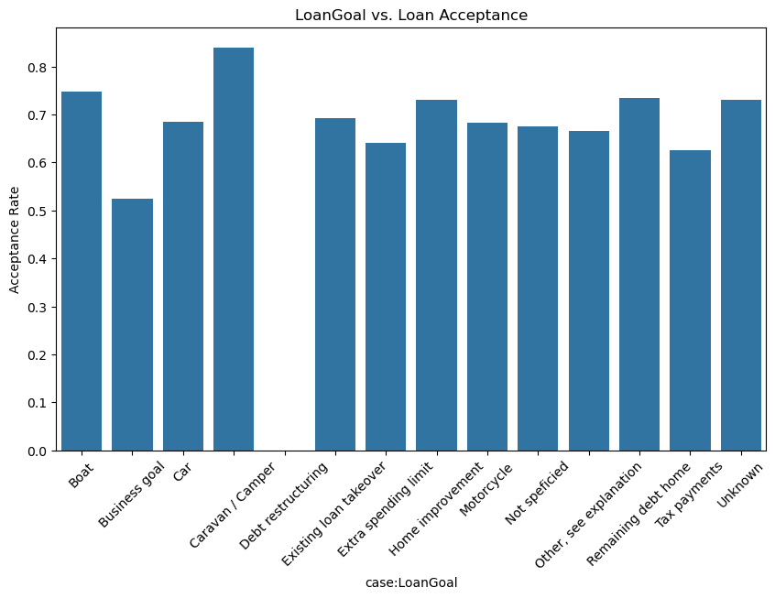
Acceptance Rate Vs Loan Goals

Slide 35

Acceptance Rate Vs Application Type

Slide 36

Acceptance Rate Vs Number of Terms

Slide 37

Acceptance Range Vs Requested Amount

Slide 38

Interest Rate Vs Loan Goals

Slide 39

Interest Rate Vs Requested Amount

Slide 40

Interest Rate Vs Number of Terms

Slide 41

Rejection Rate Vs Loan Goals

Slide 42

Rejection Rate Vs Application Type

Slide 43

Rejection Rate Vs Number of Terms

Slide 44

Rejection Rate Vs Credit Score

